Slide 1

Modes of operation: one time key
Online Cryptography Course Dan Boneh
Using block ciphers
example: encrypted email, new key for every message.

Slide 2
Using PRPs and PRFs
Goal: build “secure” encryption from a secure PRP (e.g. AES).
This segment: one-time keys
Adversary’s power:
Adv sees only one ciphertext (one-time key)
Adversary’s goal:
Learn info about PT from CT (semantic security)
Next segment: many-time keys (a.k.a chosen-plaintext security)
Notes:
Today: we build ciphers that are semantically secure against one-time use
And ciphers that are semantically secure against many-time use

Slide 3
Incorrect use of a PRP
Electronic Code Book (ECB):
Problem:
if m₁=m₂ then c₁=c₂
PT:
m₁
m₂
CT:
c₁
c₂

Slide 4
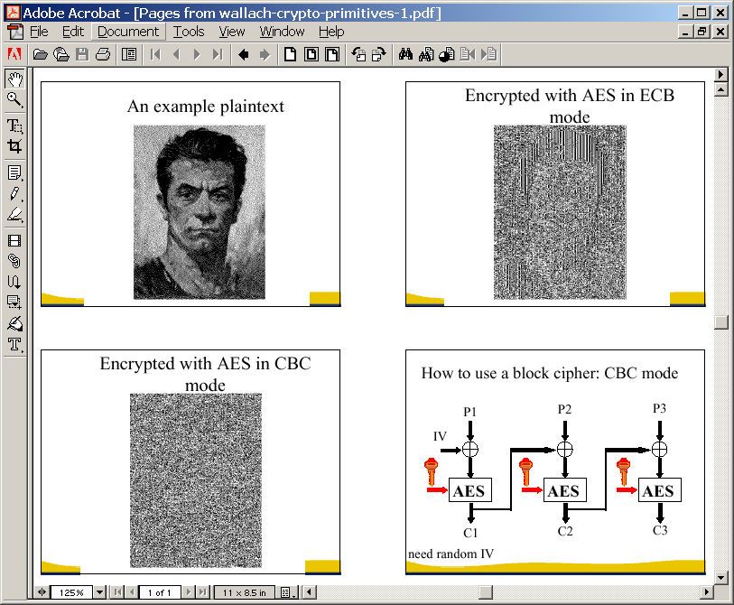
In pictures
(courtesy B. Preneel)

Slide 5
Semantic Security (one-time key)
EXP(0):
Chal.
m₀ , m₁ ∈ M : |m₀| = |m₁|
Adv. A
k←K
c ← E(k,m₀)
b’ ∈ {0,1}
one time key ⇒ adversary sees only one ciphertext
Chal.
m₀ , m₁ ∈ M : |m₀| = |m₁|
Adv. A
EXP(1):
k←K
c ← E(k,m₁)
b’ ∈ {0,1}
Adv_{SS}[A,OTP] = | Pr[ EXP(0)=1 ] − Pr[ EXP(1)=1 ] | should be “neg.”

Slide 6
ECB is not Semantically Secure
ECB is not semantically secure for messages that contain more than one block.
b∈{0,1}
Two blocks
m₀ = “Hello World”
m₁ = “Hello Hello”
Chal.
Adv. A
k←K
(c₁,c₂) ← E(k, m_{b})
If c₁=c₂ output 0, else output 1
Then Adv_{SS} [A, ECB] = 1

Slide 7
Secure Construction I
Deterministic counter mode from a PRF F :
E_{DETCTR} (k, m) =
⇒ Stream cipher built from a PRF (e.g. AES, 3DES)
m[0]
m[1]
…
m[L]
⊕
F(k,0)
F(k,1)
…
F(k,L)
c[0]
c[1]
…
c[L]

Slide 8
Det. counter-mode security
Theorem: For any L>0, If F is a secure PRF over (K,X,X) then E_{DETCTR} is sem. sec. cipher over (K,X^{L},X^{L}).
In particular, for any eff. adversary A attacking E_{DETCTR} there exists a n eff. PRF adversary B s.t.:
Adv_{SS}[A, E_{DETCTR}] = 2 ⋅ Adv_{PRF}[B, F]
Adv_{PRF}[B, F] is negligible (since F is a secure PRF) Hence, Adv_{SS}[A, E_{DETCTR}] must be negligible.

Slide 9
Proof
m₀ , m₁
m₀ , m₁
chal.
adv. A
chal.
≈_{p}
adv. A
c ←
m0
m0
k←K
⊕
f←Funs
c ←
⊕
F(k,0) … F(k,L)
f(0) … f(L)
b’≟1
b’≟1
≈_{p}
≈_{p}
m₀ , m₁
m₀ , m₁
chal.
adv. A
≈_{p}
chal.
adv. A
c ←
m1
r←{0,1}^{n}
c ←
m1
k←K
⊕
⊕
F(k,0) … F(k,L)
f(0) … f(L)
b’≟1
b’≟1

Slide 10
End of Segment

